Slide 1
Hibernate Mapping Object Relationships

Slide 2
Object Relationships
Hibernate mappings are one of the key features of hibernate .
They establish the relationship between two database tables as attributes in your model.
Allows you to easily navigate the associations in your model and criteria queries.
You can establish either unidirectional or bidirectional i.e you can either model them as an attribute on only one of the associated entities or on both.
It will not impact your database mapping tables, but it defines in which direction you can use the relationship in your model and criteria queries.

Slide 3
Object Relationships / Mappings
The relationship that can be established between entities are-
one to one — it represents the one to one relationship between two tables.
one to many/many to one — it represents the one to many relationship between two tables.
many to many — it represents the many to many relationship between two tables.

Slide 4
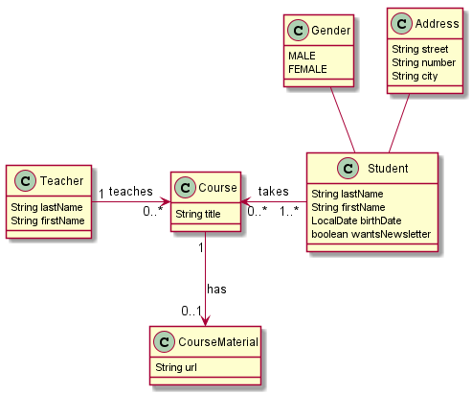
Example
Here is what this model looks like:

Slide 5
Relationships
First of all, let's define a relationship.
If we look at our class diagram we can see a few relationships:
Teachers and courses
students and courses
courses and course materials.

Slide 6
One-to-Many/Many-to-One
As its name implies, it's a relationship that links one entity to many other entities.
One-to-Many and Many-to-One relationships, which are closely related
You could go ahead and say that they're the opposite sides of the same coin.
In our example, this would be a Teacher and their Courses.
A teacher can give multiple courses, but a course is given by only one teacher (that's the Many-to-One perspective - many courses to one teacher).
Another example could be on social media - a photo can have many comments, but each of those comments belongs to that one photo.

Slide 7
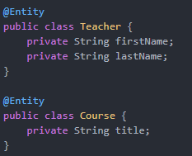

One-to-Many/Many-to-One
create our entities
the fields of the Teacher class should include a list of courses.
Since we'd like to map this relationship in a database, we'll annotate it with a @OneToMany annotation:

Slide 8

One-to-Many/Many-to-One
How does JPA reflect this relationship in the database?
Generally, for this type of relationship, we must use a foreign key in a table.
JPA does this for us, given our input on how it should handle the relationship.
This is done via the @JoinColumn annotation:
Using this annotation will tell JPA that the COURSE table must have a foreign key column TEACHER_ID that references the TEACHER table's ID column.

Slide 9

Owning Side and Bidirectionality
The Teacher class is called the owning side of the One-To-Many relationship.
This is because it defines the join column between the two tables.
The Course is called the referencing side in that relationship.
We could've made Course the owning side of the relationship by mapping the Teacher field with @ManyToOne in the Course class instead
There's no need to have a list of courses in the Teacher class now.
The relationship would've worked the opposite way:

Slide 10
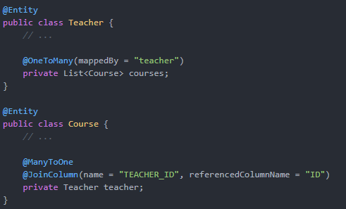
Owning Side and Bidirectionality
what if we still want our Teacher class to offer access to its Course list?
We can do that by defining a bidirectional relationship:

Slide 11
Owning Side and Bidirectionality
We keep our @ManyToOne mapping on the Course entity.
However, we also map a list of Courses to the Teacher entity.
What's important to note here is the use of the mappedBy flag in the @OneToMany annotation on the referencing side.
Without it, we wouldn't have a two-way relationship. We'd have two one-way relationships.
Both entities would be mapping foreign keys for the other entity.
With it, we're telling JPA that the field is already mapped by another entity.
It's mapped by the teacher field of the Course entity.

Slide 12
Eager vs Lazy Loading
Another thing worth noting is eager and lazy loading.
With all our relationships mapped, it's wise to avoid impacting the software's memory by putting too many entities in it if unnecessary.
Imagine that Course is a heavy object, and we load all Teacher objects from the database for some operation.
We don't need to retrieve or use the courses for this operation, but they're still being loaded alongside the Teacher objects.
This can be devastating for the application's performance

Slide 13

Eager vs Lazy Loading
JPA thought ahead and made One-to-Many relationships load lazily by default.
This means that the relationship won't be loaded right away, but only when and if actually needed.
Many-to-One relationships are eager by default, meaning the relationship is loaded at the same time the entity is.
We can change these characteristics by setting the fetch argument of both annotations

Slide 14

Fetching strategies
Hibernate uses a fetching strategy to retrieve associated objects if the application needs to navigate the association.
Fetch strategies can be declared in the O/R mapping metadata, or over-ridden by a particular HQL or Criteria query.
Fetching Strategies uses the FetchMode property.

Slide 15
FetchMode vs. FetchType
FetchMode defines how Hibernate will fetch the data (by select, join or subselect).
FetchType, on the other hand, defines whether Hibernate will load data eagerly or lazily.

Slide 16
Cascading
Entity relationships often depend on the existence of another entity —
for example, the Person–Address relationship.
Without the Person, the Address entity doesn't have any meaning of its own.
When we delete the Person entity, our Address entity should also get deleted.
Cascading is the way to achieve this.
When we perform some action on the target entity, the same action will be applied to the associated entity.

Slide 17
JPA Cascade Type
ALL : propagates all operations — including Hibernate-specific ones — from a parent to a child entity.
PERSIST : The persist operation makes a transient instance persistent. CascadeType PERSIST propagates the persist operation from a parent to a child entity.
MERGE : The merge operation copies the state of the given object onto the persistent object with the same identifier. CascadeType.MERGE propagates the merge operation from a parent to a child entity.

Slide 18
JPA Cascade Type
REMOVE : remove operation removes the row corresponding to the entity from the database and also from the persistent context. CascadeType.REMOVE propagates the remove operation from parent to child entity.
REFRESH : Refresh operations re-read the value of a given instance from the database. In some cases, we may change an instance after persisting in the database, but later we need to undo those changes. When we use this operation with CascadeType REFRESH, the child entity also gets reloaded from the database whenever the parent entity is refreshed.
DETACH : The detach operation removes the entity from the persistent context. When we use CascaseType.DETACH, the child entity will also get removed from the persistent context.

Slide 19
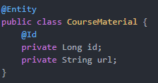

One-to-One
instead of having a relationship between one entity on one side and a bunch of entities on the other, we'll have a maximum of one entity on each side.
the relationship between a Course and its CourseMaterial
The annotation for mapping a single entity to a single other entity is, @OneToOne.
Before setting it up in our model, let's remember that a relationship has an owning side - preferably the side which will hold the foreign key in the database.

Slide 20


One-to-One
In our example, that would be CourseMaterial as it makes sense that it references a Course
There is no point in having material without a course to encompass it. That's why the relationship is not optional in that direction.
Let's make the relationship bidirectional, so we can access the material of a course if it has one. In the Course class, let's add:
Here, we're telling Hibernate that the material within a Course is already mapped by the course field of the CourseMaterial entity.
Also, there's no optional attribute here as it's true by default, and we could imagine a course without material (from a very lazy teacher).
In addition to making the relationship bidirectional, we could also add cascading operations or make entities load eagerly or lazily.

Slide 21
Many-to-Many
Effectively, in a database, a Many-to-Many relationship involves a middle table referencing both other tables.
the Many-to-Many relationship will be the one between Student and Course instances as a student can attend multiple courses, and a course can be followed by multiple students.
In order to map a Many-to-Many relationship we'll use the @ManyToMany annotation.
However, this time around, we'll also be using a @JoinTable annotation to set up the table that represents the relationship:

Slide 22
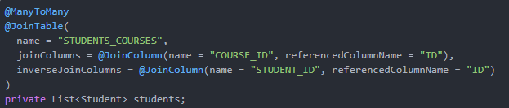
Many-to-Many
The annotation takes a few parameters.
First of all, we must give the table a name. We've chosen it to be STUDENTS_COURSES.
we'll need to tell Hibernate which columns to join in order to populate STUDENTS_COURSES.
The first parameter, joinColumns defines how to configure the join column (foreign key) of the owning side of the relationship in the table. In this case, the owning side is a Course.
On the other hand, the inverseJoinColumns parameter does the same, but for the referencing side (Student).

